Slide 1

CAPSTONE PROJECT 2
SQL & MS Excel – CHEOW CHONG HUA

Slide 2
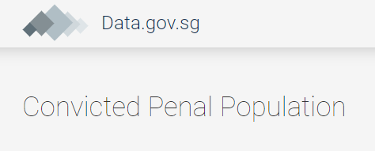
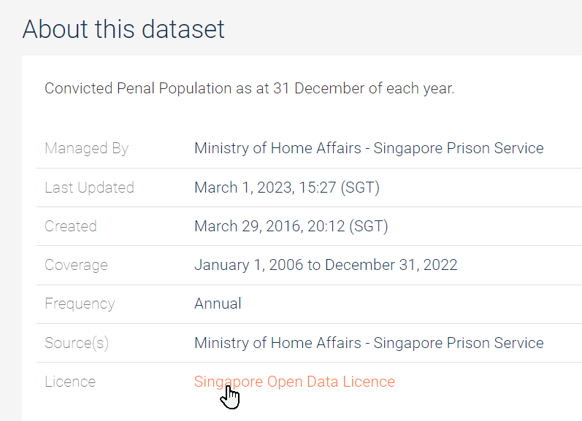


Viewing

Slide 3
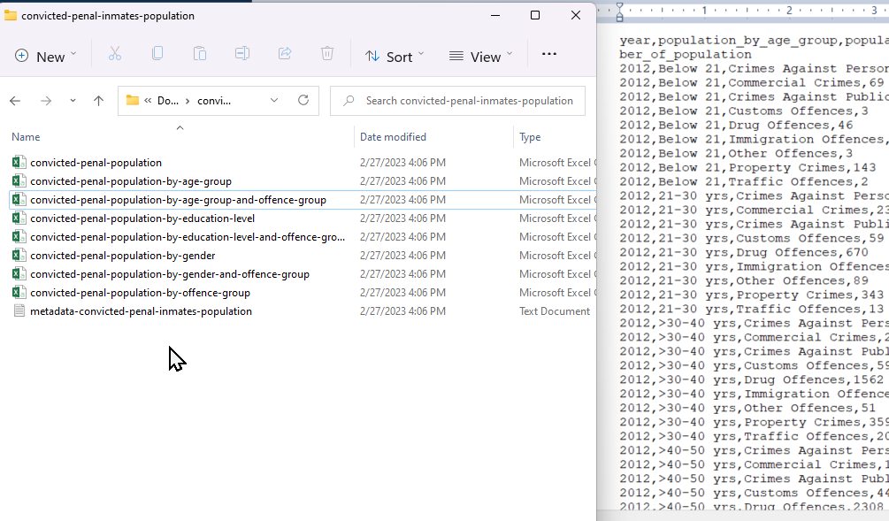
Analyze the content of datasets available for use
Plan for normalization into tables
Bind relationship with keys

Slide 4

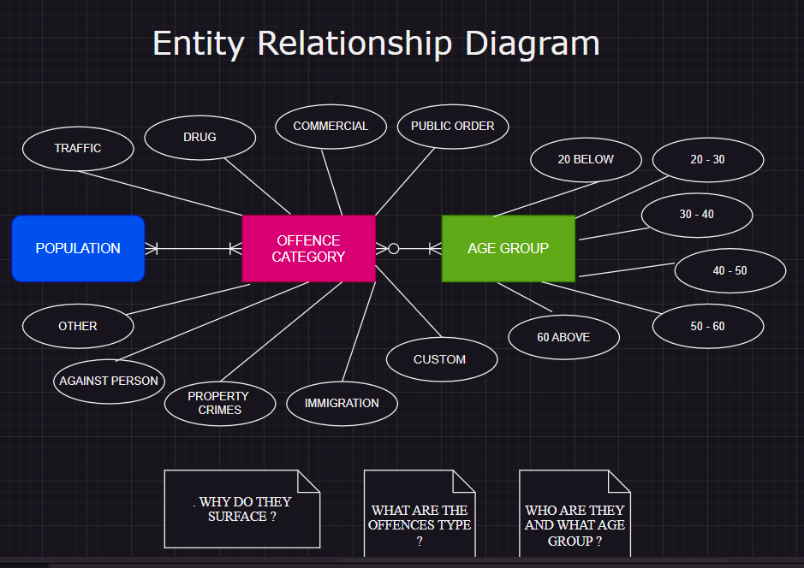

Slide 5
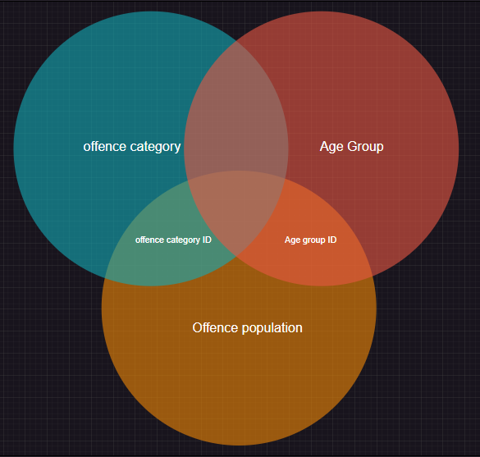
Conceptualized
Inner join
Offence category & Age group with offence population table

Slide 6
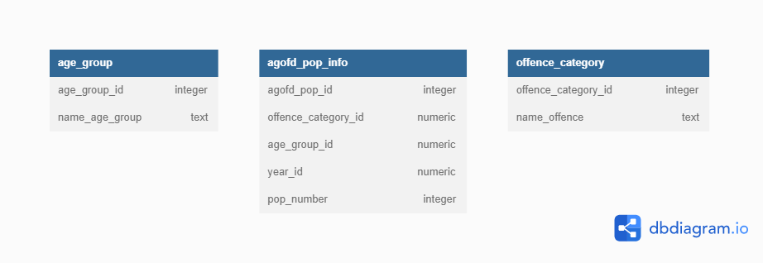
DESIGNING SCHEMA DIAGRAM
DECIDE THE DATA TYPE TO USE AND RELATION TO BIND THE TABLES

Slide 7
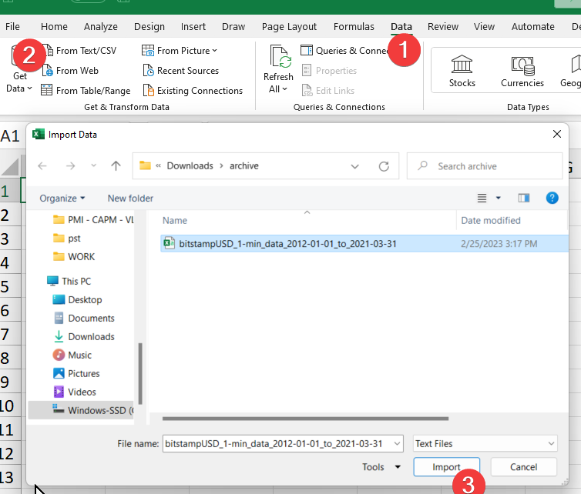
Data Preparation & Cleaning
IMPORT CSV DATASET INTO MICROSOFT EXCEL

Slide 8
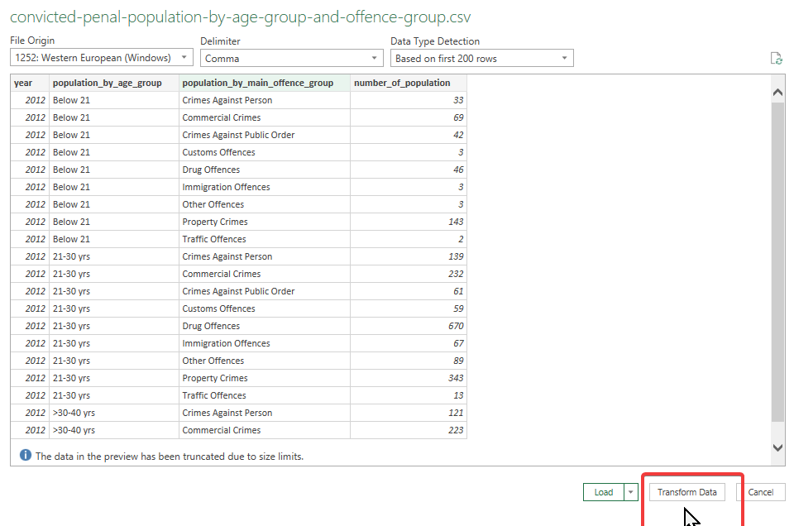
Transform data
Split into 3 tables which are:
1. Age group
2. Offence category
3. Population of offence

Slide 9
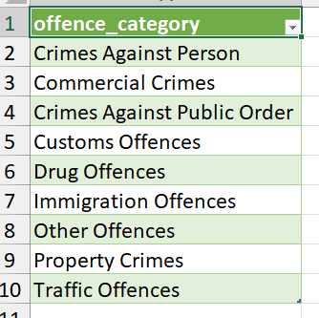
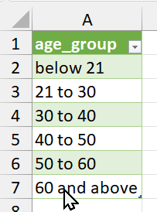
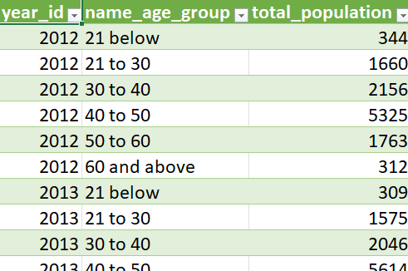
TABLES
Saved as csv file

Slide 10
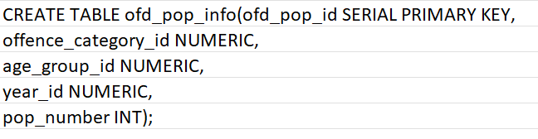
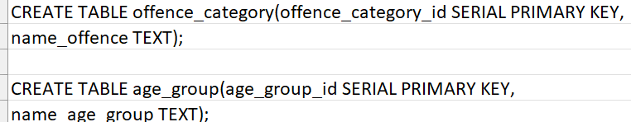


PGAdmin
TABLES Creation

Slide 11
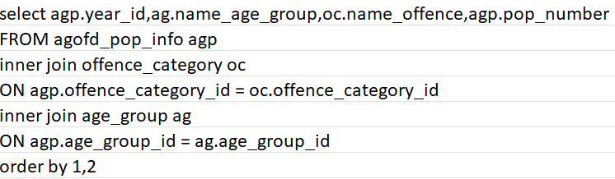
INNER JOIN TABLES to form the ‘base table’

Slide 12
‘Is there a ‘faster’ and ‘cleaner way to do this repetitive query ?’
Solution > CREATE VIEW !

Slide 13
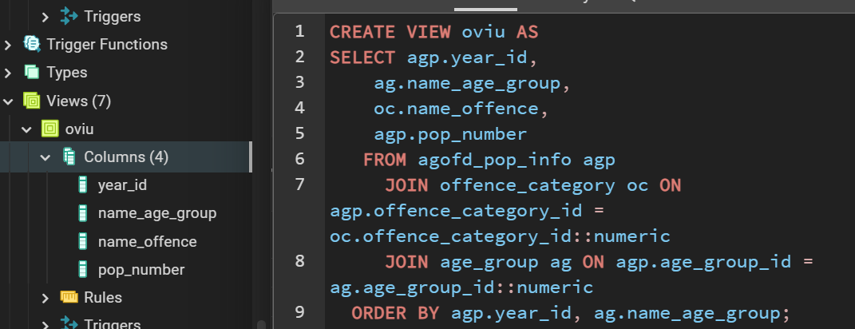
View creation

Slide 14
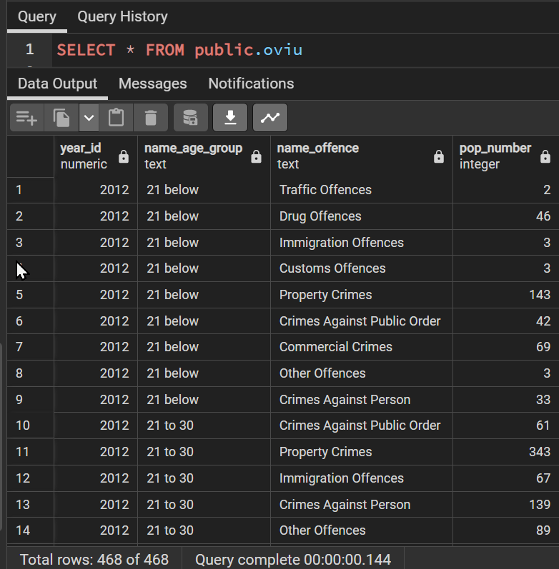
VIEW
To perform cleaner and quicker query

Slide 15
‘Is there a way to further query deeper into each age group category that has the top 5 offence population ?’
Solution > Common Table Expression !

Slide 16
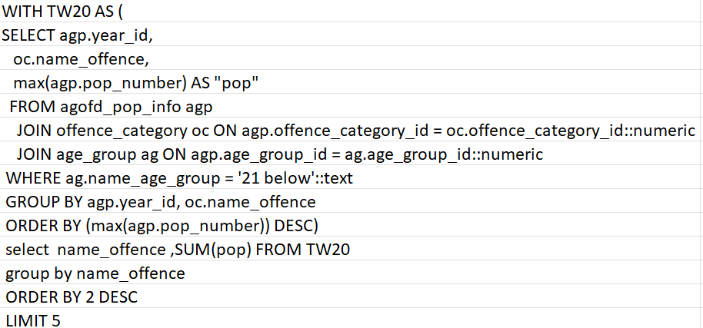
VIEW
Common Table Expression to find the top 5 most committed offence

Slide 17
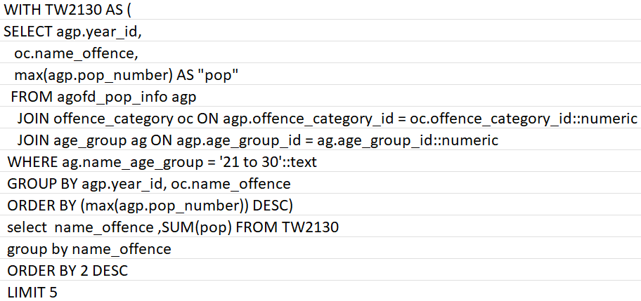
VIEW
Common Table Expression to find the top 5 most committed offence

Slide 18
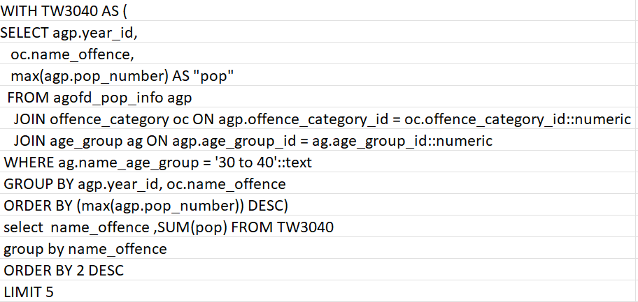
VIEW
Common Table Expression to find the top 5 most committed offence

Slide 19
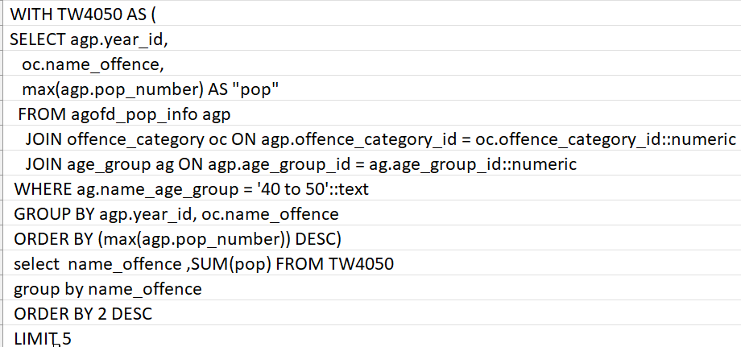
VIEW
Common Table Expression to find the top 5 most committed offence

Slide 20
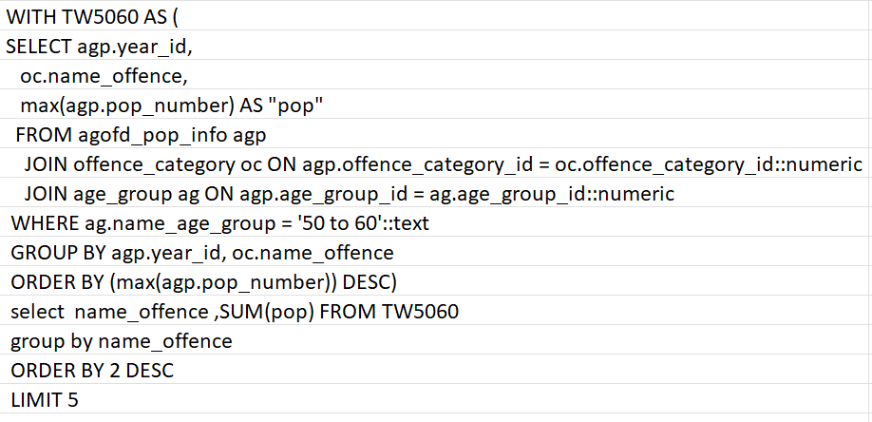
VIEW
Common Table Expression to find the top 5 most committed offence

Slide 21
VIEW
WITH TW6000 AS (
SELECT agp.year_id,
oc.name_offence,
max(agp.pop_number) AS "pop"
FROM agofd_pop_info agp
JOIN offence_category oc ON agp.offence_category_id = oc.offence_category_id::numeric
JOIN age_group ag ON agp.age_group_id = ag.age_group_id::numeric
WHERE ag.name_age_group = '60 and above'::text
GROUP BY agp.year_id, oc.name_offence
ORDER BY (max(agp.pop_number)) DESC)
select name_offence ,SUM(pop) FROM TW6000
group by name_offence
ORDER BY 2 DESC
LIMIT 5
Common Table Expression to find the top 5 most committed offence

Slide 22
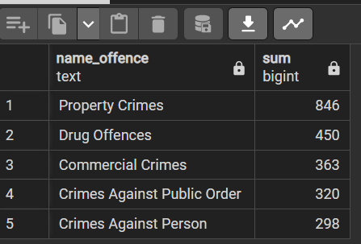
What are the TOP 5 offence 21 below

Slide 23
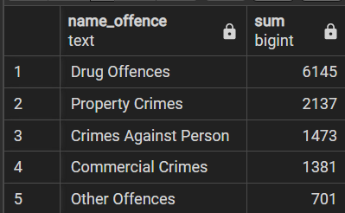
What are the TOP 5 offence 21 - 30

Slide 24
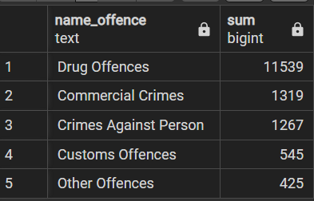
What are the TOP 5 offence 30 - 40

Slide 25
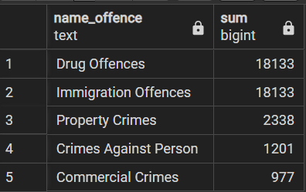
What are the TOP 5 offence 40 - 50

Slide 26
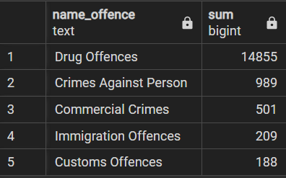
What are the TOP 5 offence 50 - 60

Slide 27
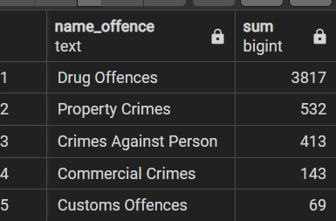
What are the TOP 5 offence 60 and above

Slide 28
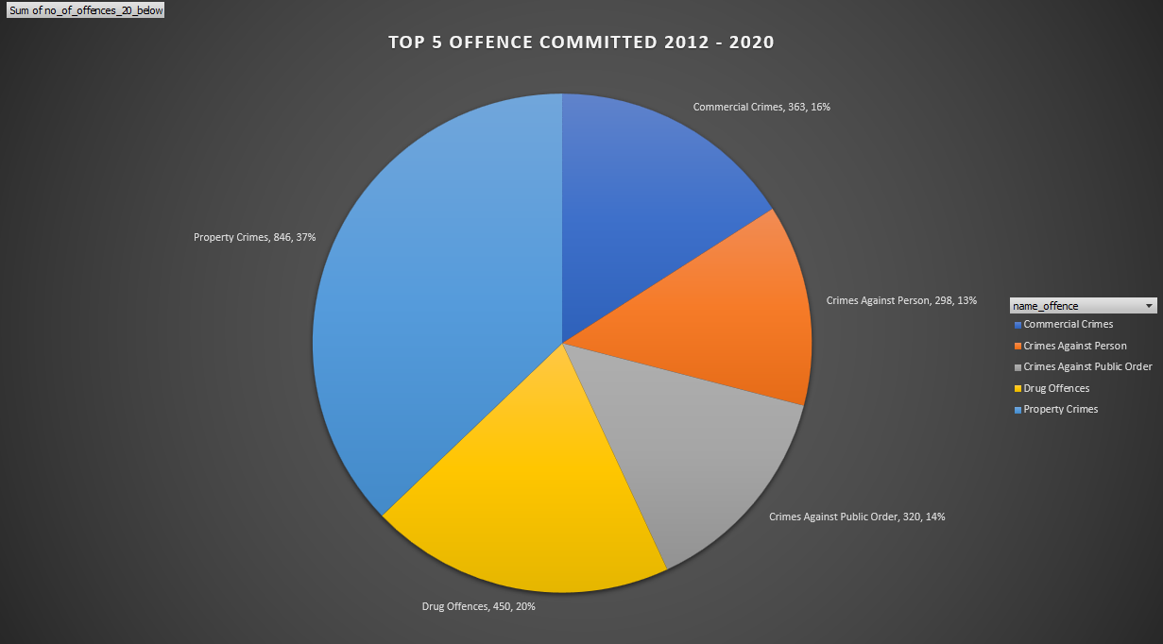
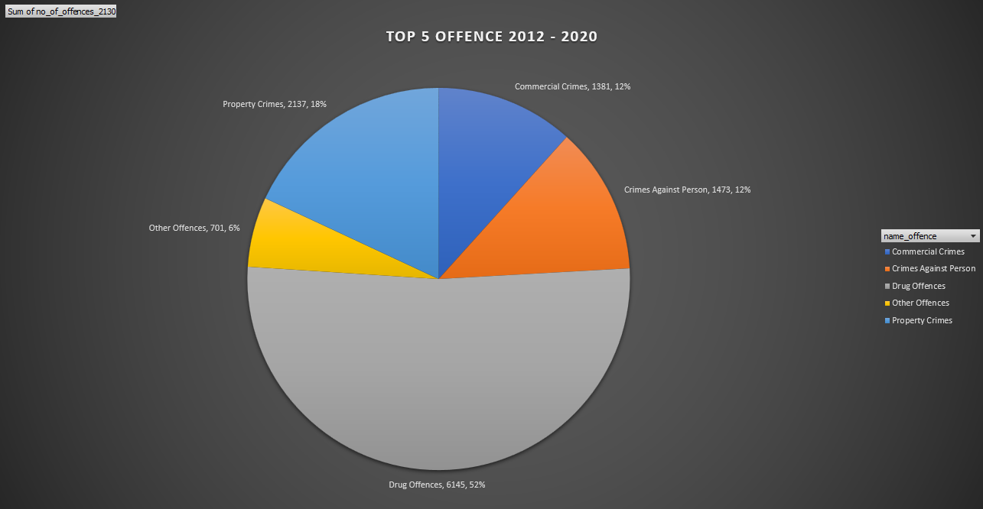
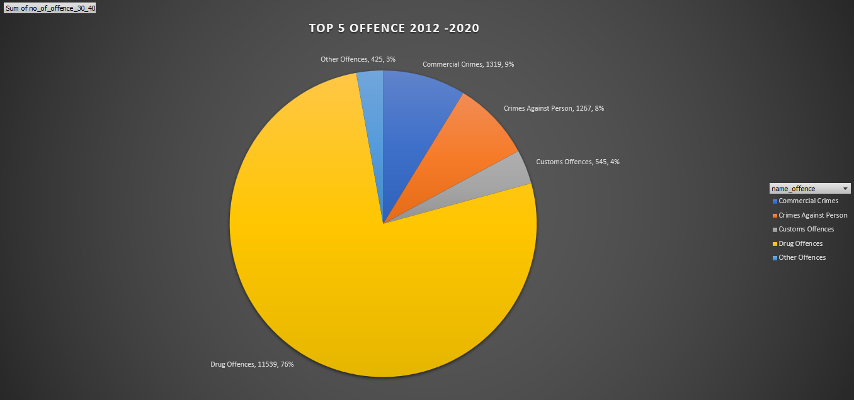
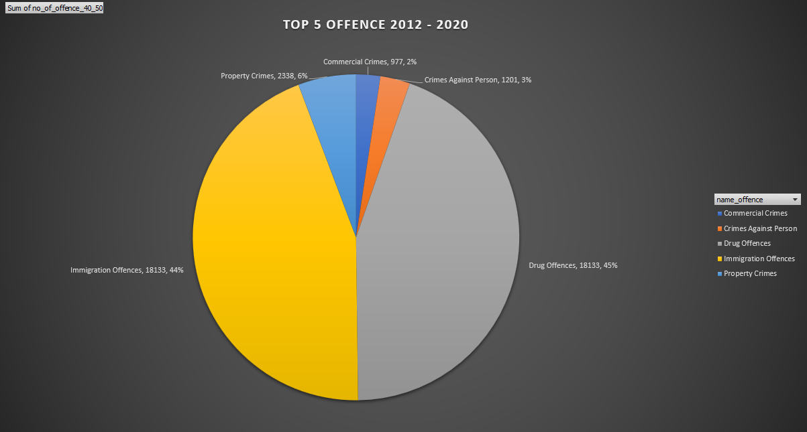
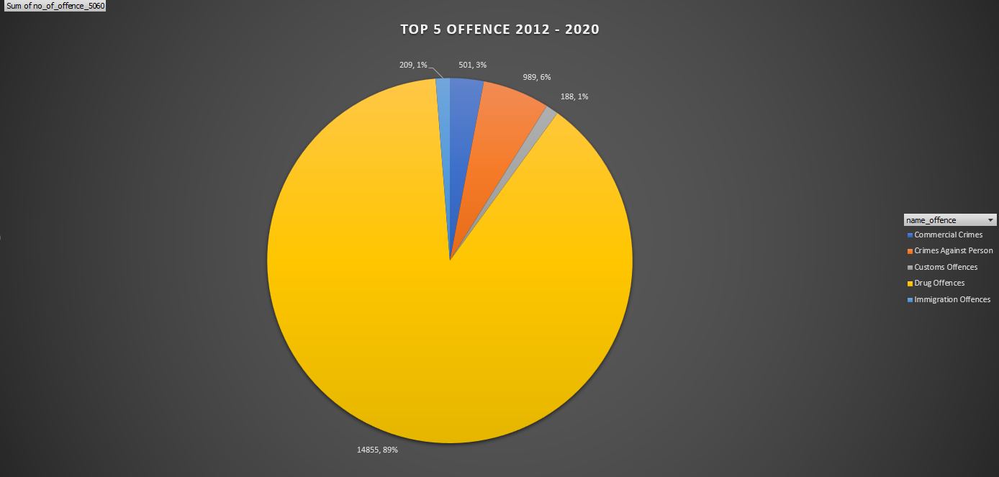
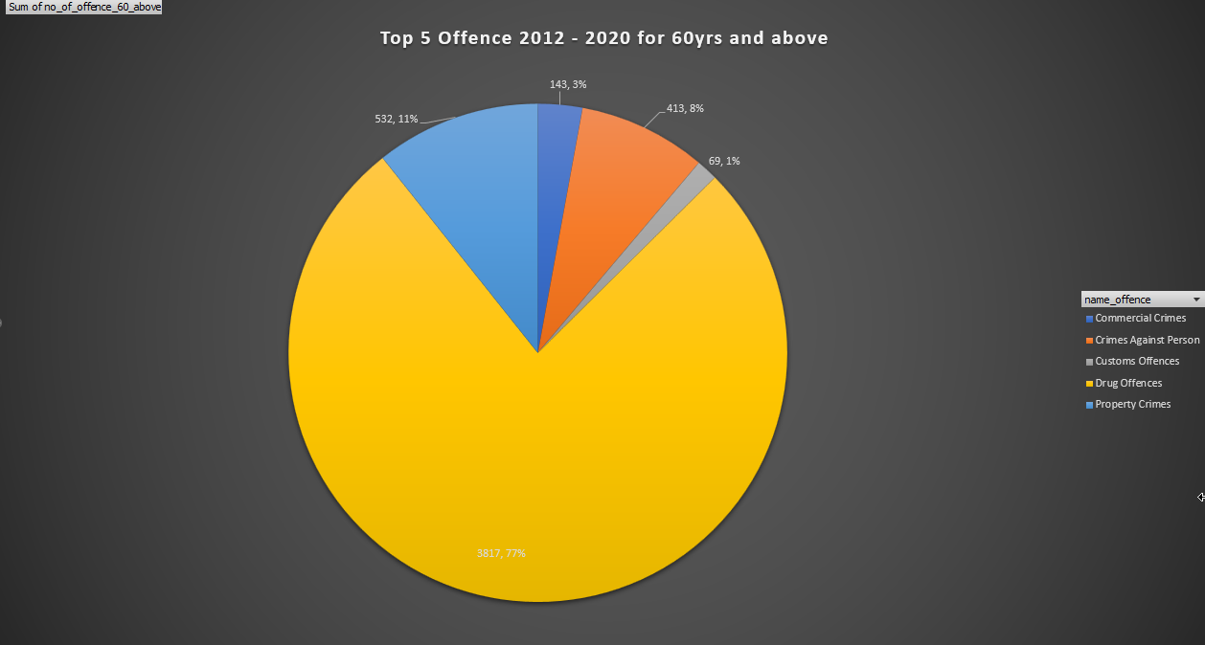

Slide 29
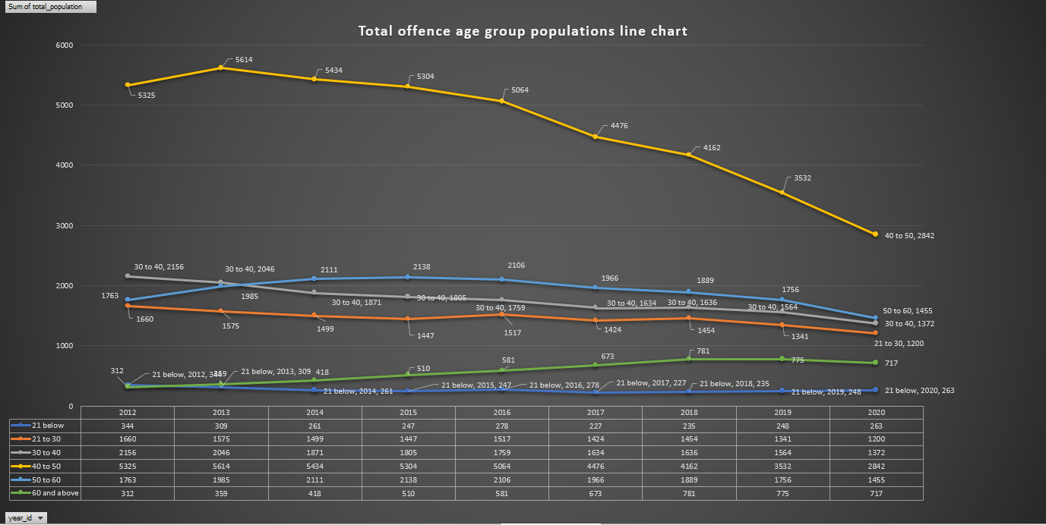

Slide 30
Insights- DRUGS OFFENCE
Rewards that are so enormous.
Despite the death penalty if possess 3 tea-spoon of drugs.

Slide 31
Insights
DRUGS offence tops the list which reflect how compelling for people in all age group to ‘gamble’ to gain rewards that are so enormous.
Also it also raise the question whether it is a ‘social health’ issue because those addicted will commit the offence over and over again.
DEATH Penalty indeed is a deterrent as the figures shows the numbers declines since 2012 to 2020

Slide 32
Insights
Property offence tops the age group 20 & below as a revenue for quick and easy money

Slide 33
THANK-YOU
SQL & MS Excel Capstone project 2 – CHEOW CHONG HUA

